Slide 1

Operator Overloading

Slide 2
Operator Overloading
int a=5, b=10,c;
c = a + b;
Operator + performs addition of
integer operands a, b
time t1,t2,t3;
t3 = t1 + t2;
Operator + performs addition of
objects of type time
string str1=“Hello”
string str2=“Good Day”;
string str3;
str3 = str1 + str2;
Operator + concatenates two strings str1,str2

Slide 3

Operator overloading
Function overloading allow you to use same function name for different definition.
Operator overloading extends the overloading concept to operators, letting you assign multiple meanings to C++ operators
Operator overloading giving the normal C++ operators such as +, * and == additional meanings when they are applied with user defined data types.
Operator | Purpose
Some of C++ Operators are already overloaded
* | As pointer, As multiplication
<< | As insertion, As bitwise shift left
& | As reference, As bitwise AND

Slide 4
Operator Overloading
Specifying more than one definition for an operator in the same scope, is called operator overloading.
You can overload operators by creating “operator functions”.
Syntax:
Return_type operator op_symbol(argument_list)
{
// statements
}
Keyword
substitute the operator
Example:
void operator + (arguments);
int operator - (arguments);
Class_name operator / (arguments);
float operator * (arguments);
Notes:
To define an additional task to an operator , we must specify what it means in relation to class to which operator is applied. This is done with the help of special function is called operator function
C++ allows you to specify more than one definition for a function name or an operator in the same scope, which is called function overloading and operator overloading respectively.
We can give special meaning to any operators in which program it is implemented.

Slide 5
Rules for operator overloading
Only existing operator can be overloaded.
The overloaded operator must have at least one operand that is user defined type.
We cannot change the basic meaning and syntax of an operator.

Slide 6
Rules for operator overloading (Cont…)
When using binary operators overloaded through a member function, the left hand operand must be an object of the relevant class.
We cannot overload following operators.
Operator | Name
. and .* | Class member access operator
:: | Scope Resolution Operator
sizeof() | Size Operator
?: | Conditional Operator

Slide 7
Overloading Unary Operator

Slide 8
Overloading Unary operator −−
int main()
{
space s1(5,4,3);
s1.display();
--s1;
s1.display();
return 0;
}
class space {
int x,y,z;
public:
space(){
x=y=z=0;}
space(int a, int b,int c){
x=a; y=b; z=c; }
void display(){
cout<<"\nx="<<x<<",y="<<y<<",z="<<z;
}
void operator--();
};
void space::operator--() {
x--;
y--;
z--;
}

Slide 9
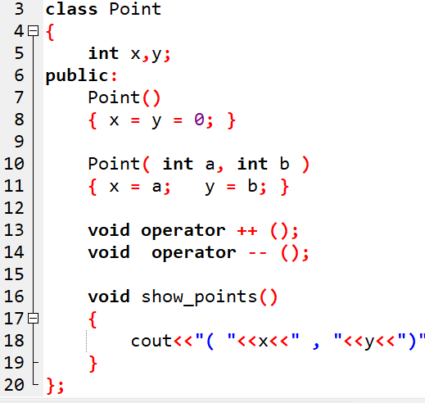
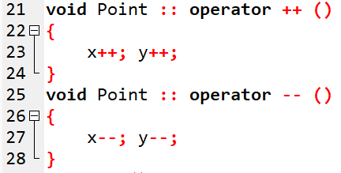
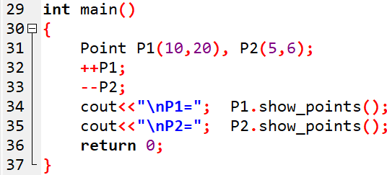

Example: Unary operator overloading
OUTPUT

Slide 10
Overloading Unary operator −
int main()
{
space s1(5,4,3);
s1.display();
-s1;
s1.display();
return 0;
}
class space {
int x,y,z;
public:
space(){
x=y=z=0;}
space(int a, int b,int c){
x=a; y=b; z=c; }
void display(){
cout<<"\nx="<<x<<",y="<<y<<",z="<<z;
}
void operator-();
};
void space::operator-() {
x=-x;
y=-y;
z=-z;
}

Slide 11
Increment and Decrement Operators
When postfix (++ or --) is used with a variable in an expression, the expression is evaluated first using the original value of the variable and then the variable is incremented or decremented by one.
When prefix (++ or --) is used with a variable in an expression, variable is incremented or decremented first and then the expression is evaluated using the new value of the variable.
Notes:
11

Slide 12
Increment and Decrement Operators
Examples:
m = 5;
y = ++m;
In this case, the value of y and m would be 6.
m = 5;
y = m++;
Here y continues to be 5. Only m changes to 6.
Notes:
12

Slide 13
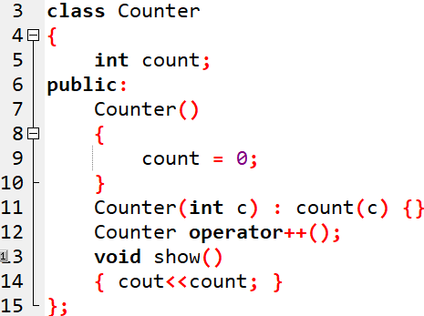
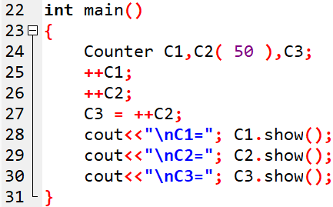
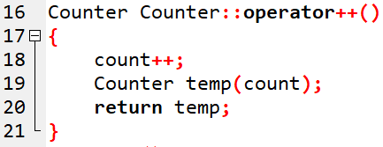

OUTPUT:
Notes:
Counter operator ++ () //increment count
{
++count; //increment count
Counter temp; //make a temporary Counter
temp.count = count; //give it same value as this obj
return temp; //return the copy

Slide 14
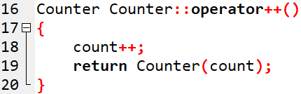
Example: Nameless Temporary Objects
OUTPUT:
Notes:
increment count, then return
return Counter(count); // an unnamed temporary object
} // initialized to this count. There are more convenient ways to return temporary objects from functions and overloaded
operators.

Slide 15
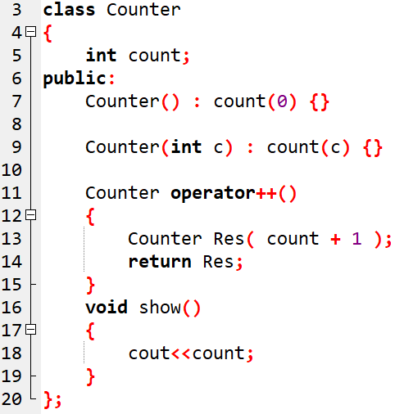
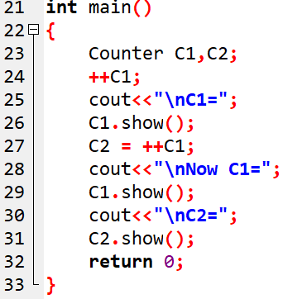

Question-1:

Slide 16
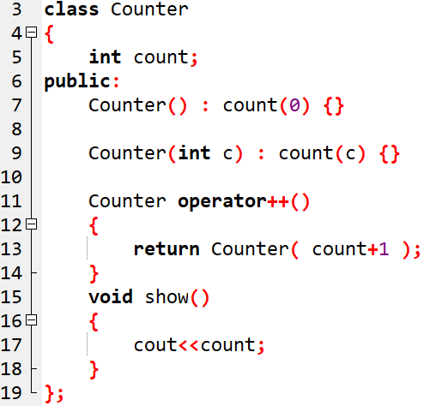

Slide 17
Overloading Prefix and Postfix operator
class demo
{
int m;
public:
demo(){ m = 0;}
demo(int x)
{
m = x;
}
void operator ++()
{
++m;
cout<<"Pre Increment="<<m;
}
void operator ++(int)
{
m++;
cout<<"Post Increment="<<m;
}
};
int main()
{
demo d1(5);
++d1;
d1++;
}
Notes:
Alternatively, you can declare a member function operator operator++()with one argument having type int. The compiler uses the int argument to distinguish between the prefix and postfix increment operators. For implicit calls, the default value is zero.
C++ uses a “dummy variable” or “dummy argument” for the postfix operators. This argument is a fake integer parameter that only serves to distinguish the postfix version of increment/decrement from the prefix version.

Slide 18
int main()
{
complex c1(4,6),c2(7,9);
complex c3;
c3 = c1 + c2;
c1.disp();
c2.disp();
c3.disp();
return 0;
}
Overloading Binary operator +
class complex{
int real,imag;
public:
complex(){
real=0; imag=0;
}
complex(int x,int y){
real=x; imag=y;
}
void disp(){
cout<<"\nreal value="<<real<<endl;
cout<<"imag value="<<imag<<endl;
}
complex operator + (complex);
};
complex complex::operator + (complex c){
complex tmp;
tmp.real = real + c.real;
tmp.imag = imag + c.imag;
return tmp;
}
Similar to function call
c3=c1.operator +(c2);

Slide 19
Binary Operator Arguments
result = obj1.operator symbol (obj2);//function notation
result = obj1 symbol obj2; //operator notation
complex operator + (complex x)
{
complex tmp;
tmp.real = real + x.real;
tmp.imag = imag + x.imag;
return tmp;
}
result = obj1.display();
void display()
{
cout<<"Real="<<real;
cout<<"Imaginary="<<imag;
}

Slide 20
Binary Operator Arguments
result = obj1.operator symbol (obj2);//function notation
result = obj1 symbol obj2; //operator notation
complex operator + (complex x)
{
complex tmp;
tmp.real = real + x.real;
tmp.imag = imag + x.imag;
return tmp;
}
obj1.display();
void display()
{
cout<<"Real="<<real;
cout<<"Imaginary="<<imag;
}

Slide 21
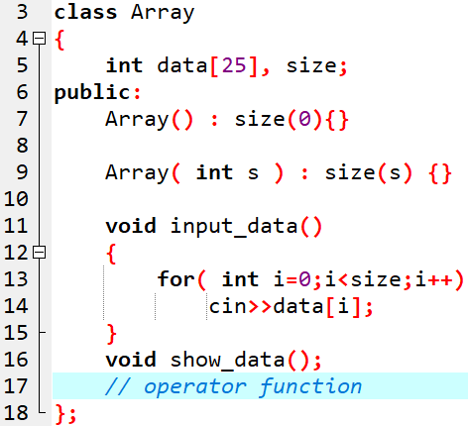
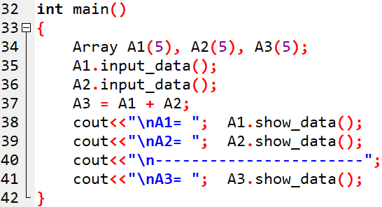
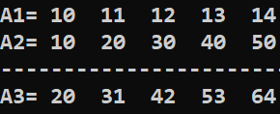
Question: Define the operator function for the following
OUTPUT

Slide 22
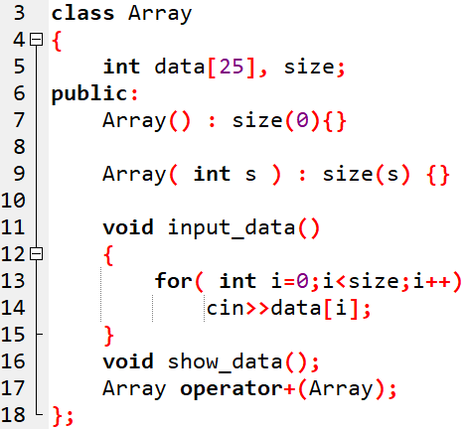
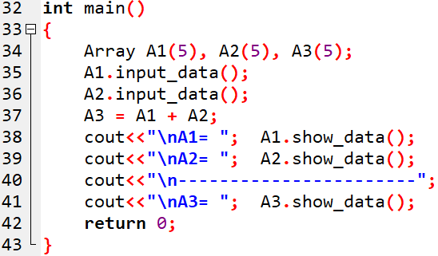

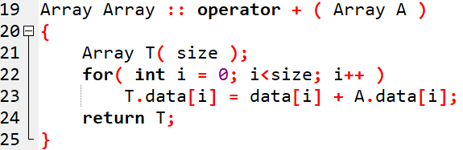
Solution:
OUTPUT

Slide 23
Operator Overloading
Operator overloading is compile time polymorphism.
You can overload most of the built-in operators available in C++.
+ | - | * | / | % | ^
& | | | ~ | ! | , | =
< | > | <= | >= | ++ | --
<< | >> | == | != | && | ||
+= | -= | /= | %= | ^= | &=
|= | *= | <<= | >>= | [] | ()
-> | ->* | new | new [] | delete | delete []

Slide 24
Operator Overloading using Friend Function

Slide 25
Operator overloading using friend function
class Some_class
{
. . . . . . . . . .
friend Ret_type operator op ( parameters );
};
Ret_type operator op (parameters )
{
. . . . . . . . . .
}

Slide 26
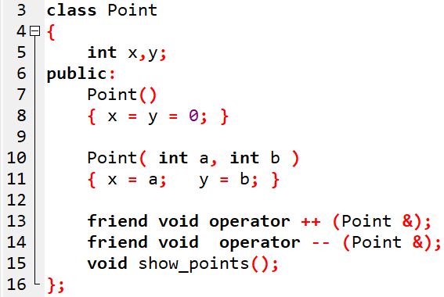
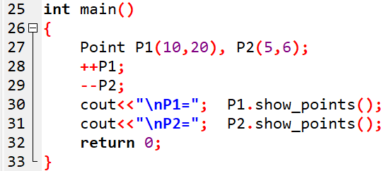
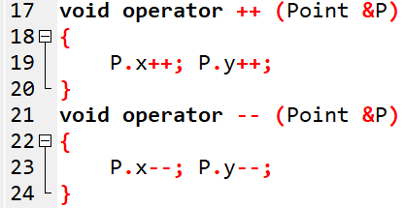

Example: Unary operator overloading using friend function
OUTPUT

Slide 27
Invoke Friend Function in operator overloading
result = operator symbol (obj1,obj2);//function notation
result = obj1 symbol obj2; //operator notation
friend complex operator +(complex c1,complex c2)
{
complex tmp;
tmp.r=c1.r+c2.r;
tmp.i=c1.i+c2.i;
return tmp;
}
int main()
{
complex c1(4,7),c2(5,8);
complex c3;
c3 = c1 + c2;
c3 = operator +(c1,c2);
}

Slide 28
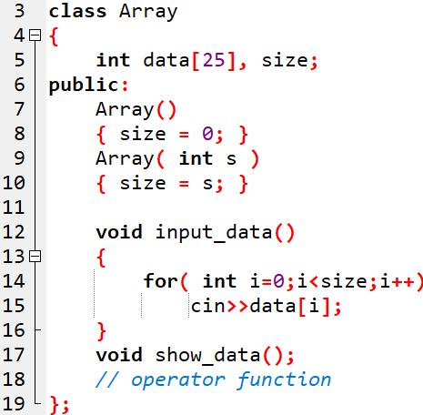
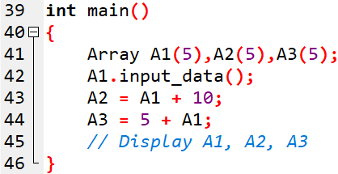

Question: Define the operator function for the following
OUTPUT

Slide 29
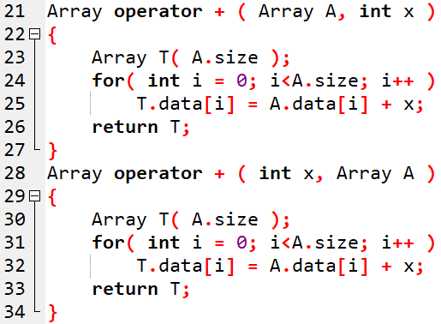
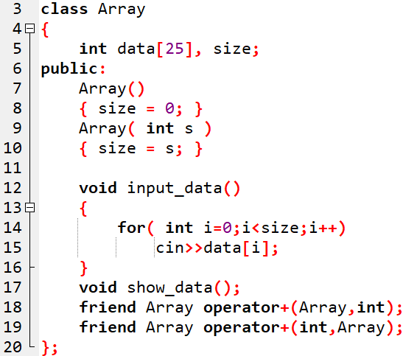

Slide 30
Overloading Binary operator ==
class complex{
int r,i;
public:
complex(){
r=i=0;}
complex(int x,int y){
r=x;
i=y;}
void display(){
cout<<"\nreal="<<r<<endl;
cout<<"imag="<<i<<endl;}
int operator==(complex);
};
int main()
{
complex c1(5,3),c2(5,3);
if(c1==c2)
cout<<"objects are equal";
else
cout<<"objects are not equal";
return 0;
}
int complex::operator ==(complex c){
if(r==c.r && i==c.i)
return 1;
else
return 0;}

Slide 31
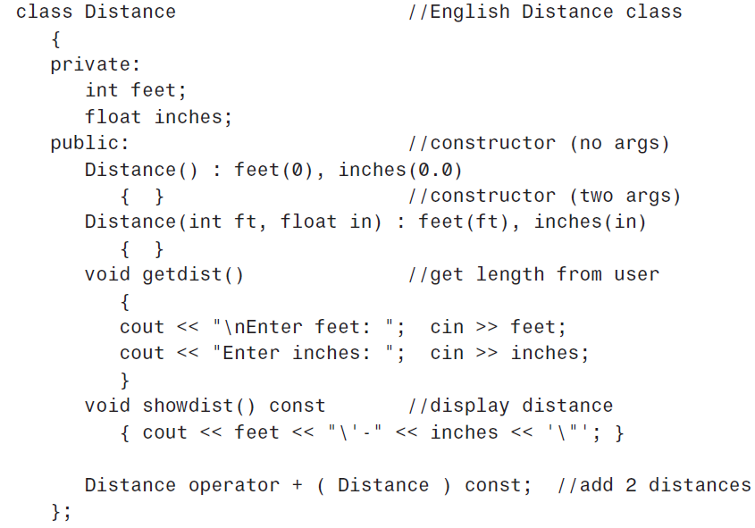

Slide 32
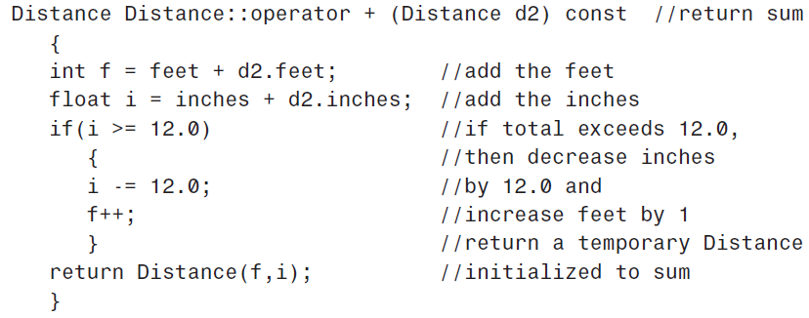
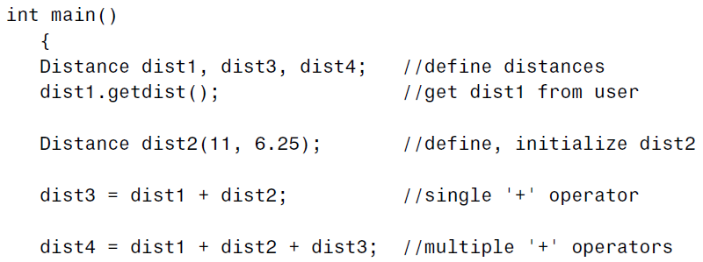
Notes:
idea of const functions is not to allow them to modify the object on which they are called.

Slide 33
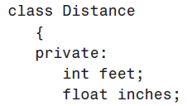
. . . . . . . . . . .

Slide 34
DATA CONVERSION

Slide 35
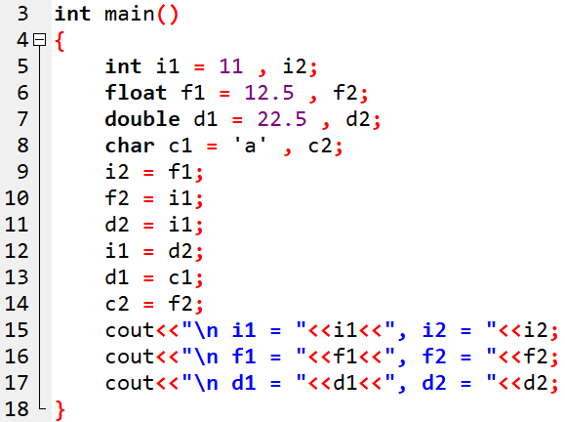

OUTPUT:

Slide 36
Type Conversion
F = C * 9/5 + 32
If different data types are mixed in expression, C++ applies automatic type conversion as per certain rules.
float
int
int a;
float b = 10.54;
a = 10;
float is converted to integer automatically by complier.
basic to basic type conversion.
a = b;
integer
(Basic)
float
(Basic)
An assignment operator causes automatic type conversion.
The data type to the right side of assignment operator is automatically converted data type of the variable on the left.

Slide 37
Type Conversion
Time t1;
int m;
m = t1;
class type will not be converted to basic type OR basic type will not be converted class type automatically.
integer
(Basic)
Time
(Class)
t1 = m;
Time
(Class)
integer
(Basic)

Slide 38
Type Conversion
C++ provides mechanism to perform automatic type conversion if all variable are of basic type.
Three types of situation arise in user defined data type conversion.
Basic type to Class type (Using Constructors)
Class type to Basic type (Using Casting Operator Function)
Class type to Class type (Using Constructors & Casting Operator Functions)

Slide 39
DATA CONVERSION
The general format of a type conversion function is:
Basic Type User_defined type : one-arg constructor
User_defined type Basic Type : Operator function
operator type ( )
{
// Conversion steps
return value;
}

Slide 40
(1) Basic to class type conversion
Basic to class type can be achieved using constructor.
class sample
{
int a;
public:
sample(){}
sample(int x){
a=x;
}
void disp(){
cout<<"The value of a="<<a;
}
};
int main()
{
int m=10;
sample s;
s = m;
s.disp();
return 0;
}

Slide 41
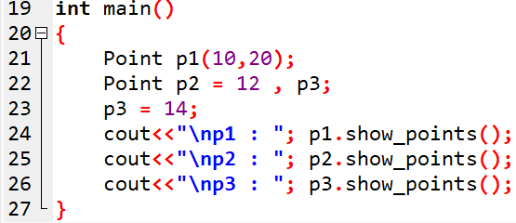
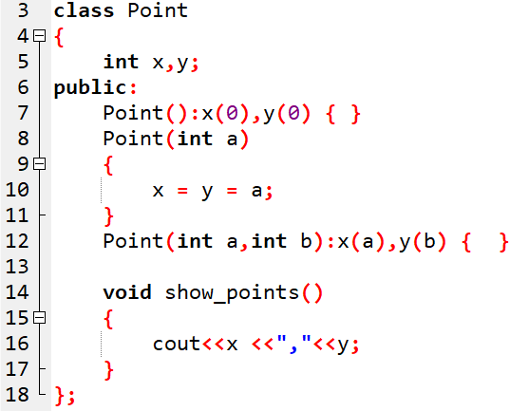

Example-: Basic → User_defined conversion
OUTPUT:

Slide 42
(2) Class to basic type conversion
The Class type to Basic type conversion is done using casting operator function.
The casting operator function should satisfy the following conditions.
  It must be a class member.
  It must not mention a return type.
  It must not have any arguments.
Syntax:
operator destinationtype()
{
....
return
}

Slide 43
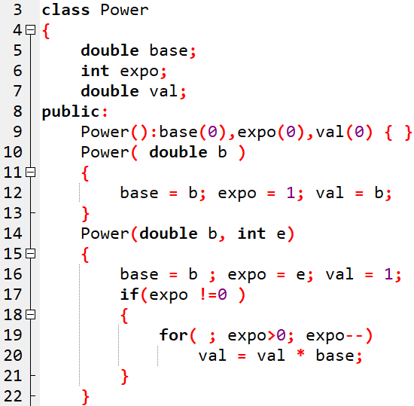
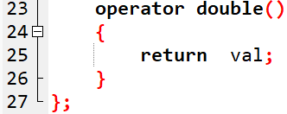
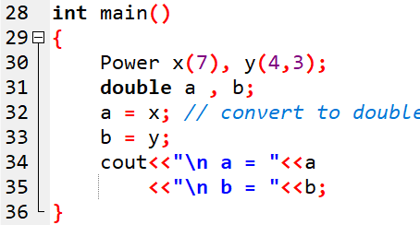

Example: UserDefined → Basic type
OUTPUT:

Slide 44
Questions:
1. To convert from a user-defined class to a basic type, you would most likely use:
  a. built-in conversion routine.
  b. one-argument constructor.
  c. a conversion operator function that’s a member of the class.
2. To convert from a basic type to a user-defined class, you would most likely use:
  a. built-in conversion routine.
  b. one-argument constructor.
  c. a conversion operator function that’s a member of the class.

Slide 45

Questions:
1. To convert from a user-defined class to a basic type, you would most likely use:
  a. built-in conversion routine.
  b. one-argument constructor.
  c. a conversion operator function that’s a member of the class.
2. To convert from a basic type to a user-defined class, you would most likely use:
  a. built-in conversion routine.
  b. one-argument constructor.
  c. a conversion operator function that’s a member of the class.

Slide 46
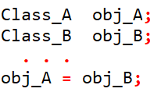
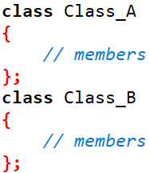

Conversions Between Objects of Different Classes:
Destination Object
Source
Object

Slide 47
(3) Class type to Class type
It can be achieved by two ways
  Using constructor
  Using conversion (casting) operator function
Two types of situation arise in user defined data type conversion.
Routine in Destination Class (Using Constructors)
Routine in Source Class (Using Conversion/Casting Operator Functions)
How do we know?
  LHS = RHS
  (Destination) = (Source)
Objective of the routines is the same
  To convert Fahrenheit to Centigrade
  To convert Kilometers to Miles/yards
  To convert Time24 to Time12
Notes:
https://www.bccfalna.com/class-type-conversion-cpp/

Slide 48
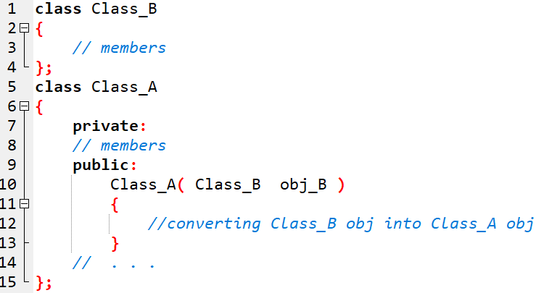
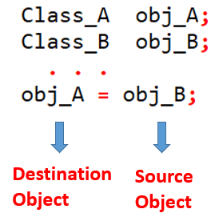
Solution-1 →Conversion routine in destination class: constructor function
Object of source class

Slide 49
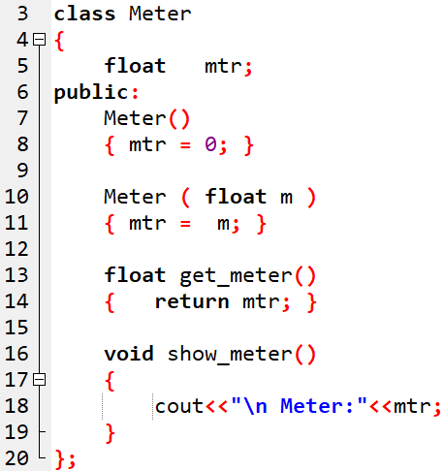
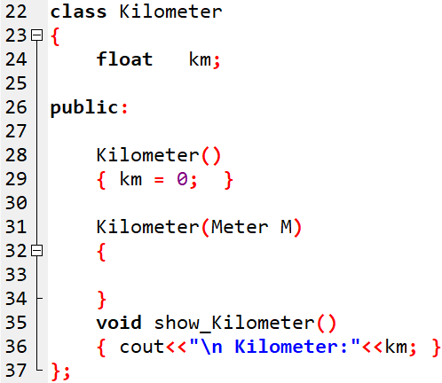
In main():
METER M(1200);
KILOMETER K = M;

Slide 50
Conversion routine in destination class: constructor function
km=M.get_meter()/1000;
In main():
METER M(1200);
KILOMETER K = M;
Notes:
km=M.get_meter()/1000;

Slide 51
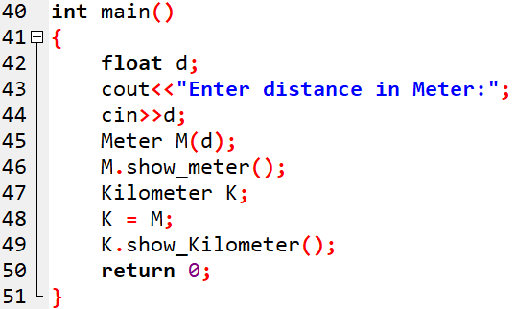
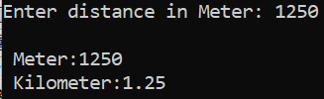

Slide 52
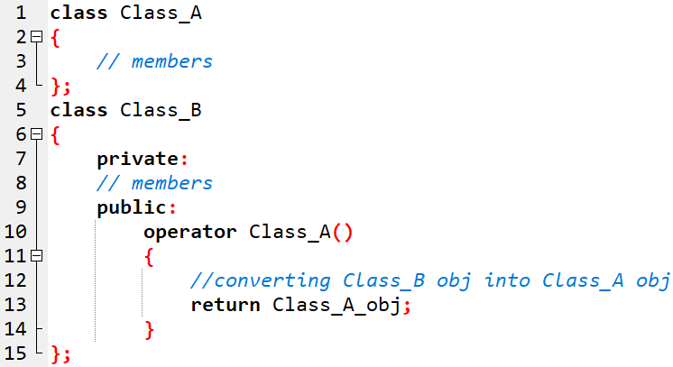
Solution2→ Conversion routine in source class: operator function
Destination object type

Slide 53
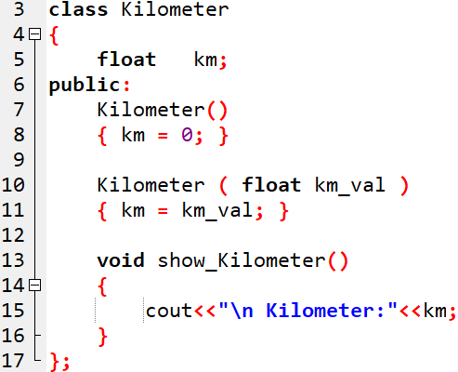
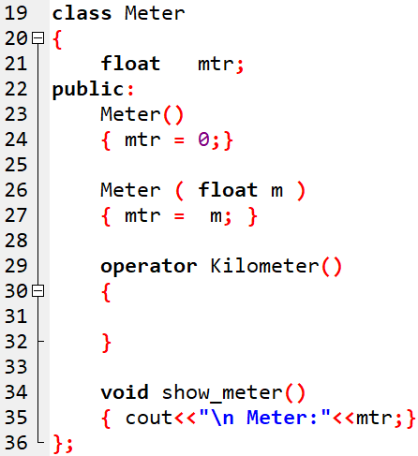
Conversion routine in source class: operator function
In main():
Meter M(1200);
Kilometer K;
K = M;

Slide 54
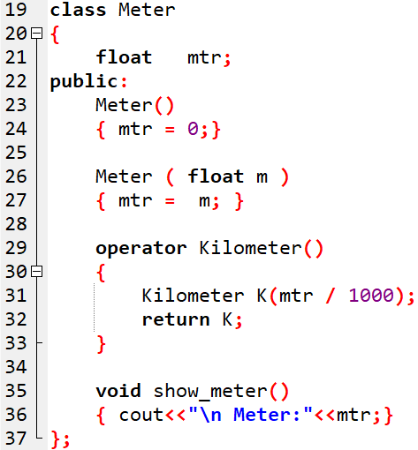
In main():
Meter M(1200);
Kilometer K;
K = M;

Slide 55
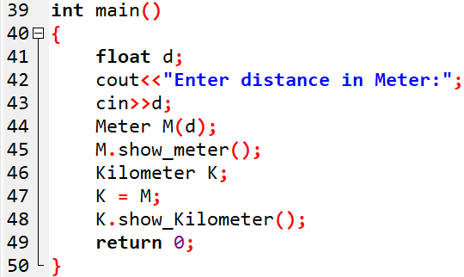


Slide 56
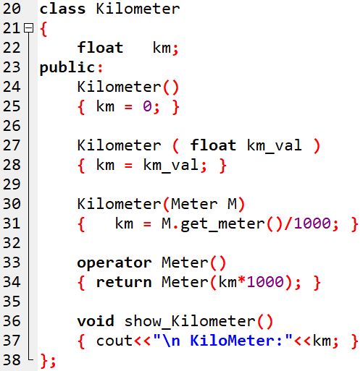
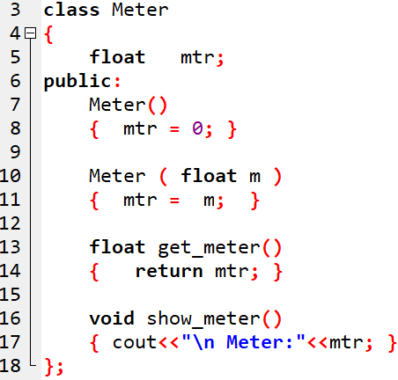
Complete conversion
Nameless object

Slide 57
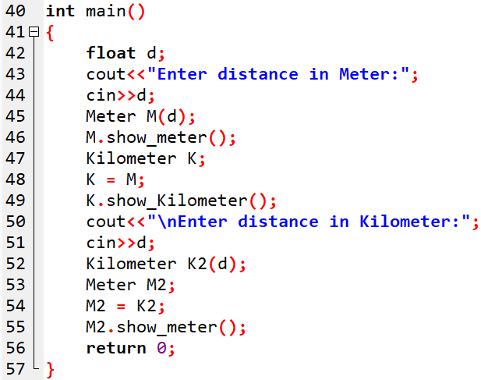
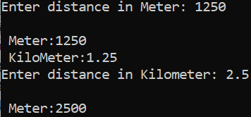

Slide 58
Write a Program to perform currency conversion: Rupee → Dollar

Slide 59
Thank You

